Slide 1

MICROPROCESSORS AND MICROCONTROLLERS (BECE204L)
DR. NAUSHAD MANZOOR LASKAR
ASSISTANT PROFESSOR SG-1
SCHOOL OF ELECTRONICS ENGINEERING (SENSE)
VELLORE INSTITUTE OF TECHNOLOGY, VELLORE

Slide 2
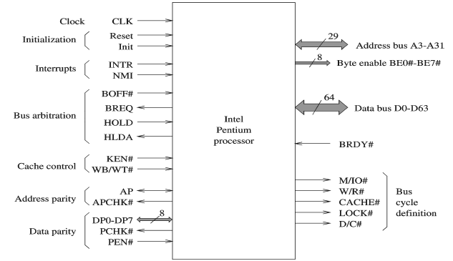
The Intel Pentium Series
External interrupt signal
Identifies the set of bytes to read or write
Introduces wait states
Distinguishes between write and read cycles
Indicates the parity check result on data read
Determines whether parity check should be used

Slide 3
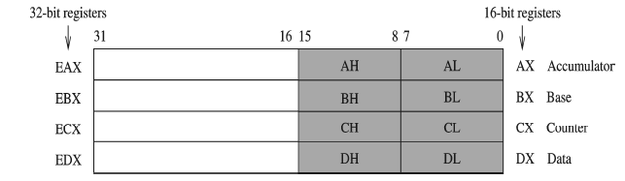
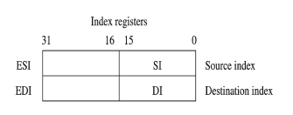
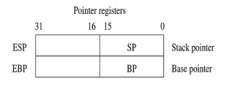
Registers in Pentium
Special Use Registers such as ECX for count in loop instructions
Two index registers
Two pointer registers
Used in string instructions
Can be used as general purpose
data registers
Used exclusively to
maintain the stack

Slide 4
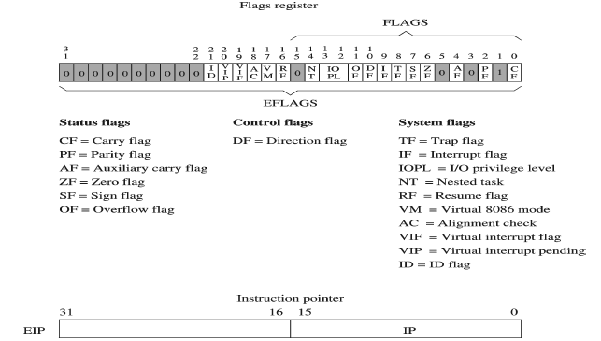
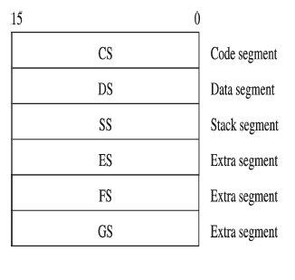
Registers in Pentium
Segment register
∗ Six 16-bit registers
∗ Support segmented memory
architecture
∗ At any time, only six
segments are accessible

Slide 5
Evolution of Microprocesors : The Intel Core/Dual Core
Name & Year | Bit Size | Description
Core | 64 | It is the first Intel microprocessor with dual core that is the implementation of 2 processors on a single chip.
Core 2 | 64 | It extends the architecture to 64-bits and core 2 Quad provides four processors on a single chip. The register set as well as addressing modes are of 64-bits. Clock Speed:1.2 GHz to 3 GHz
i3 | 64 | Entirely dual core. The clock speed is 2GHz to 3.3GHz.4 Threads
i5 | 64 | Has four cores. Clock speed :2.4GHz – 3.8GHz.
i7 | 64 | Has four cores. Clock speed :2.9GHz – 4.2GHz.8 Threads
Note:
The slowest Core i3 chips runs at a faster speed than the base Core i5 and Core i7.
The main architecture for i3 processors: Nehalem Computer Architecture, Sandy Bridge Architecture
The Hyper-Threading technology is present which reduces wait time. A thread in computing terms is a sequence of programmed instructions that the CPU has to process. For example: If a CPU consists of one core, it can process only one thread at once, so can only do one thing at once. Hyper-Threading is a clever way to let a single core handle multiple threads
Having multiple cores means that the computer can work on more than one task at a time more efficiently

Slide 6
THANK YOU

